Slide 1
<School Name>

Slide 2
Welcome
<Year in school>
<Potential area of study/rotations>
<Involvement with AMA>

Slide 3
Today’s Agenda
Meet our AMA local campus section leaders
Who is the American Medical Association?
How can the AMA help you distinguish yourself and
succeed in medical school?
  Leadership
  Research
  Advocacy
  Match
Questions
Join today!

Slide 4
Meet our AMA local campus section leadership team!
<School Name>

Slide 5
<school name>
<President>
<Firstname Lastname>
<treasurer>
<Firstname Lastname>
<CO-PREsident>
<Firstname Lastname>
<outreach leader>
<Firstname Lastname>
<Vice President>
<Firstname Lastname>
<delegate>
<Firstname Lastname>

Slide 6
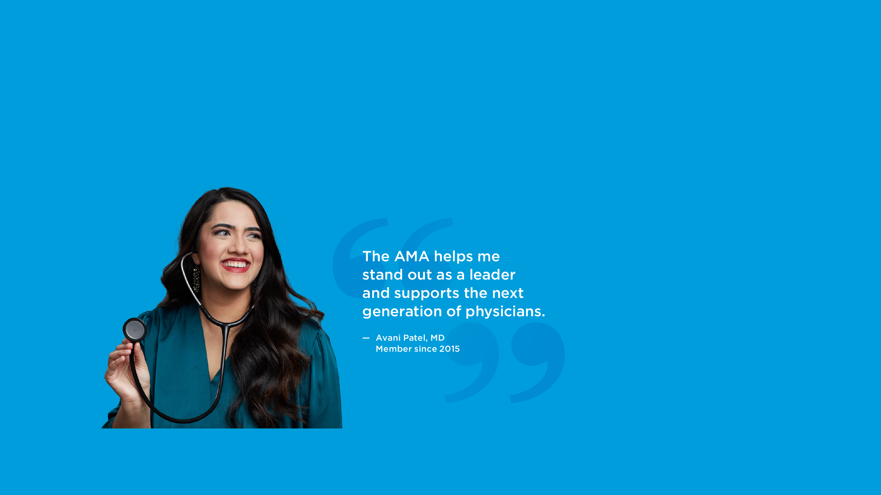
who is the
American Medical
Association?

Slide 7

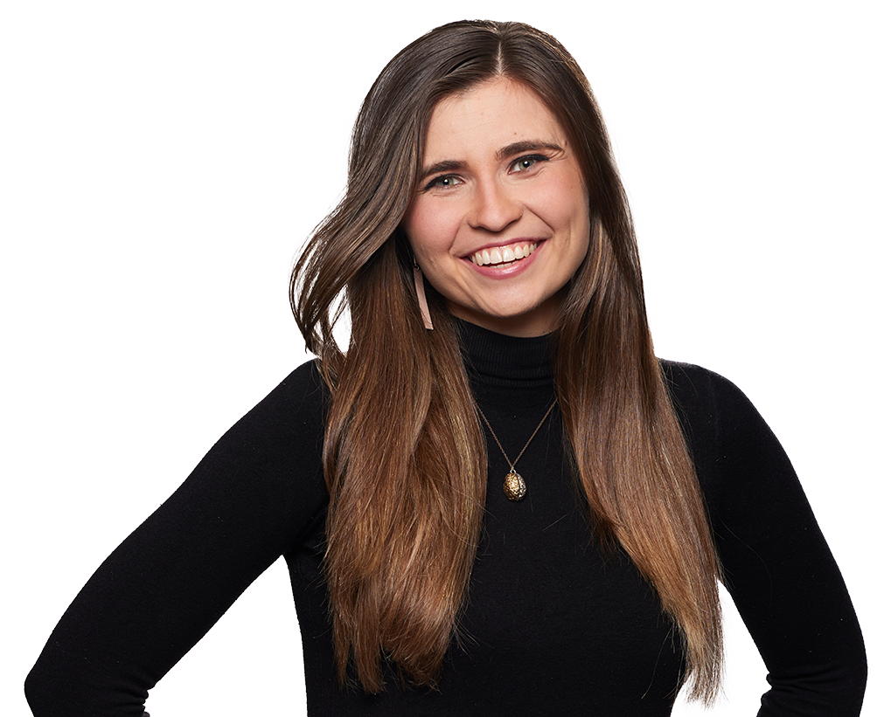
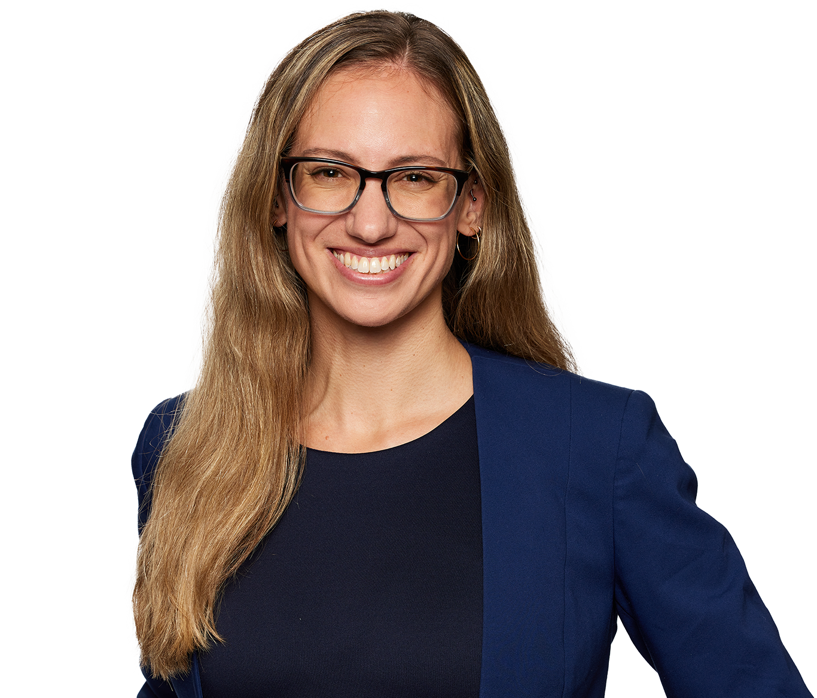
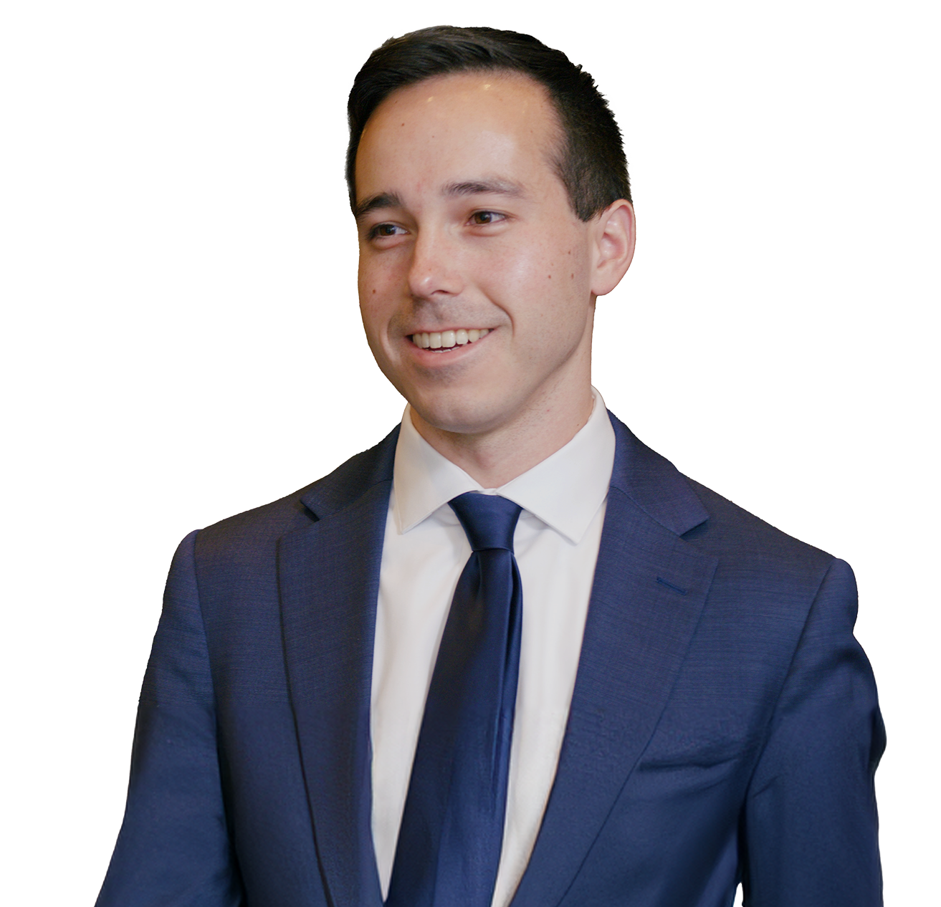
We are …
… a powerful, national organization of passionate physicians, residents and medical students who are shaping the future of medicine.
Ishaan Rischie
Member since 2022
Karen Dionesotes, MD
Member since 2013
Natasha Topolski
Member since 2018
Chris Vakkur
Member since 2023

Slide 8
Supporting you today …
… by helping you stand out and prepare for a career in medicine.
Our resources help you:
Develop leadership skills
Present your research
Learn to advocate
Prepare for residency and find your
perfect Match

Slide 9




How can the AMA help you?

Slide 10
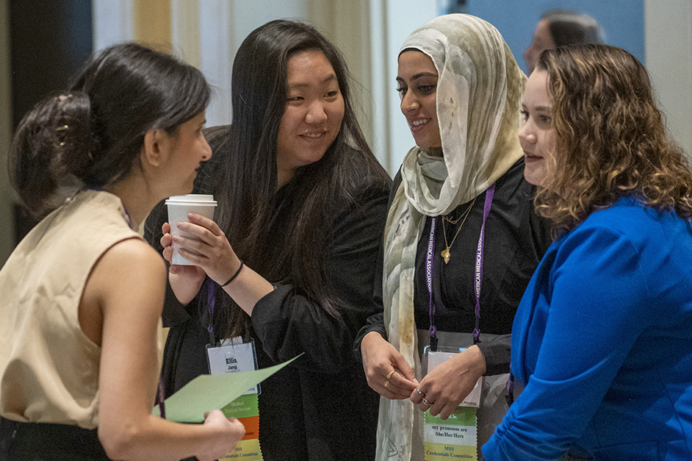
Stand out as a med student leader
Develop your leadership skills and enhance your CV
Choose from 1000+ leadership positions at the local, regional or national level
Get leadership training through the AMA Leadership Learning Series
Network with peers and industry leaders at
member-only events
Med students networking at the 2023 AMA Interim Meeting in National Harbor, Md.

Slide 11
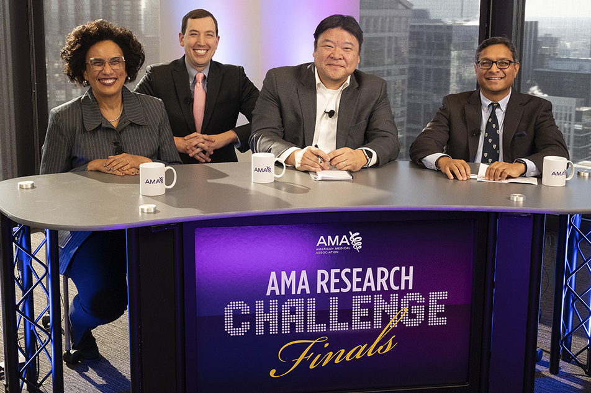
Advance your research
Present your research on a national platform and stay up
to date on the latest in medicine
Enter the AMA Research Challenge and join nearly 1,000 medical students from nearly 200 schools in competing for $10,000
Learn from the profession’s best with your subscription to JAMA® and 11 specialty journals
Get expert advice on how to present your research and make it stand out
Dr. Ehrenfeld alongside the panel of judges—
Dr. Bibbins-Domingo, Dr. Chen, Dr. Desai—
for the 2023 AMA Research Challenge Finals.

Slide 12
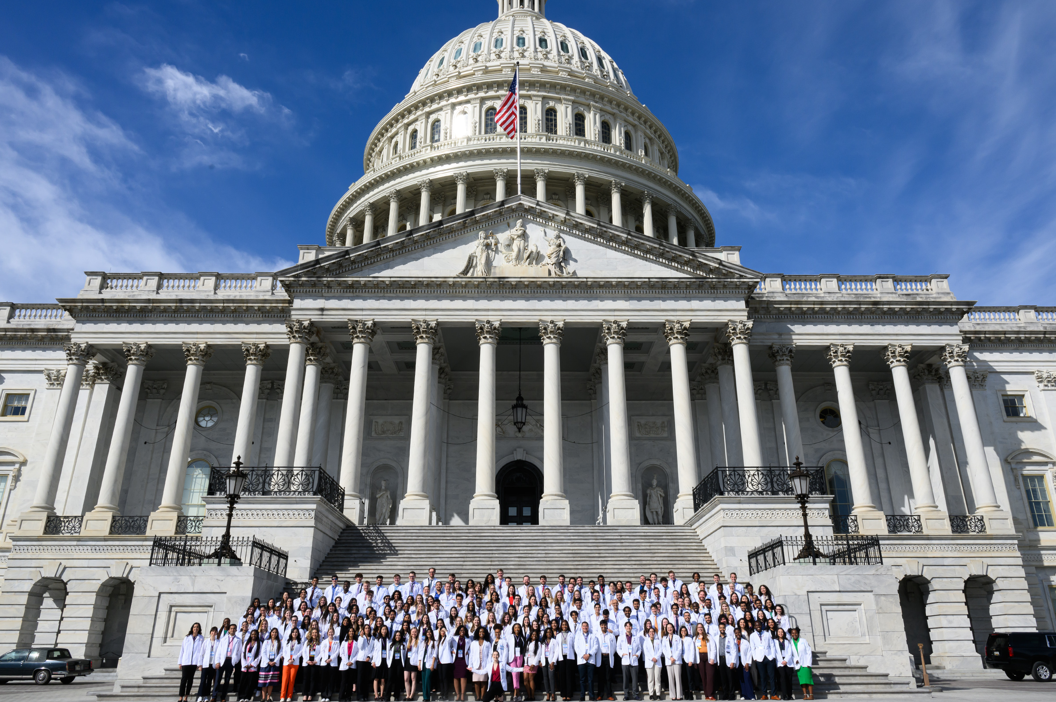
Shape the future of medicine
Learn to advocate for the issues you care about through hands-on training and events
Connect with peers who have a passion for advocacy
in the AMA Medical Student Section
Meet with legislators on Capitol Hill at the AMA Medical Student Advocacy Conference
Influence policy on a national level at the AMA Annual and Interim Meetings
Med students convene in Washington, D.C.
at the 2024 Medical Student Advocacy Conference.

Slide 13
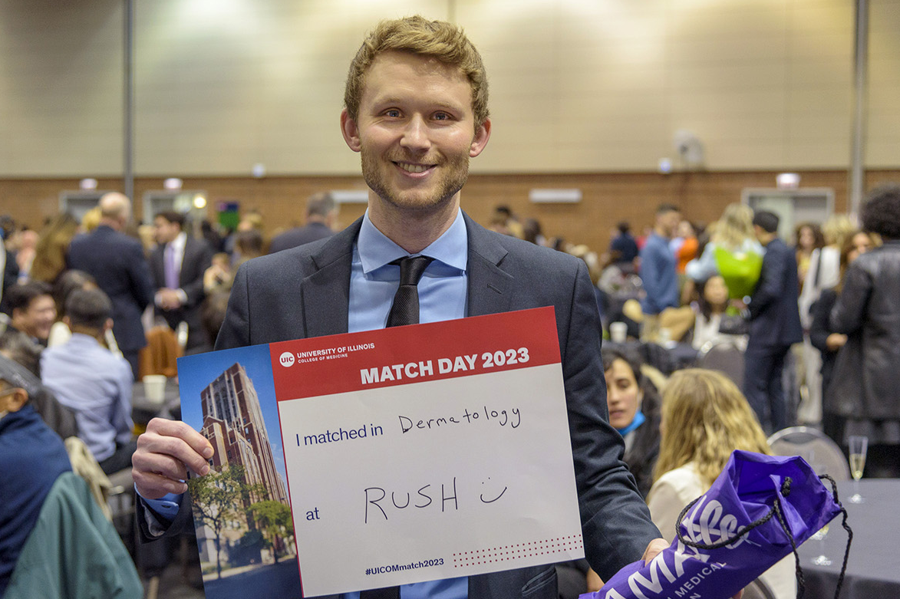
Prepare for residency and find your perfect match
Wherever you are on the road to residency, we have resources to help
Search, save and rank programs on FREIDA®, the
AMA Residency Database
Navigate the application process with our member-only “AMA Road to Residency Guide”
Get help identifying loan repayment options with a free consultation and discounted membership through Laurel Road
Med students celebrate during Match
Day 2024.

Slide 14
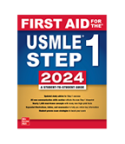



Membership Welcome gifts
Select any one of these top-tier study aids when you join the American Medical Association.*
First Aid for the USMLE 2024 (or pre-order 2025)
25% off any Sketchy subscription, 6-, 12- or 24-month plans
Up to $60 off
UWorld USMLE®
or
COMLEX-USA® QBanks
3-month subscription
Steps 1 or 2–3
* Limit one (1) Welcome gift per eligible four-year AMA student membership. Subject to change. While supplies last.

Slide 15

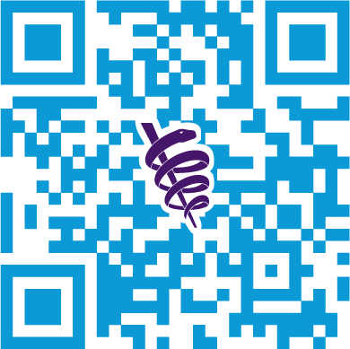
Join today and select your gift.
Supporting you today. Protecting your future.
Four-year medical student
membership, only
That’s just
$68!
$17 a year.
Text MSOP to 62802

Slide 16
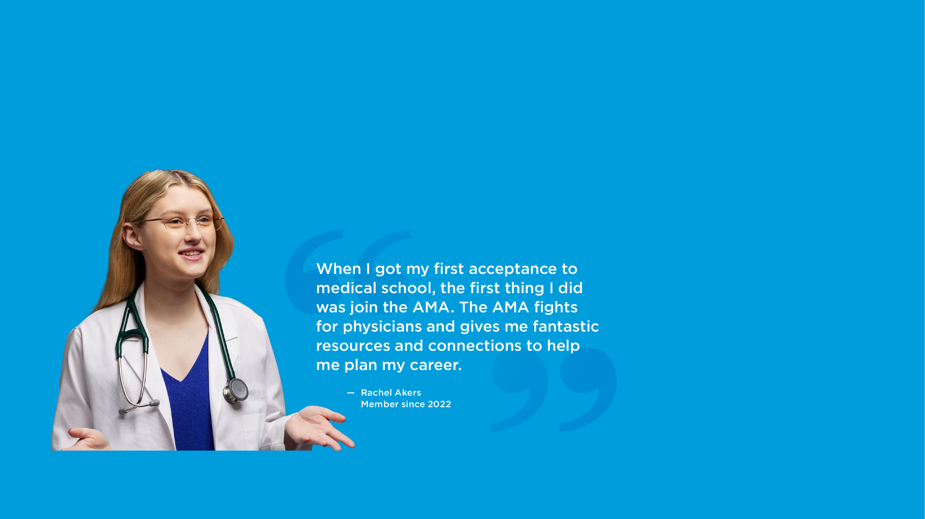
THANK YOU

